Slide 1
Best AP selection using AP Score prediction - NCGO6BMS
Internal Mentor : Dr. Kayarvizhy N External Mentor : Saranappa Raj Kumar
Kavin Kumar Thangadorai
Student members: Ajit J Gupta
Akash V
Manoj Howale S

Slide 2
EXPECTATIONS/KPI
iMPLEMENT ANDROID APP TO COLLECT WIFI DETAILS
dEFINE SCORING METHOD FOR EACH AP BASED ON ITS USAGE AND PERFORMANCE
CHECK GOOGLE AP SCORING ALGORITHM FROM ANDROID OPEN SOURCE
Select best AP based on scoring, come up with ML based technique to solve the same problem
comparE RESULTS, apply the solution to sticky banD or sticky clIENT problem in Wifi

Slide 3
Last month progress
Implementation of android app
to collect wifi details and to see the current wifi parameters.
ML model
Implementation of flask api in android app to get ml model prediction
Analysis on
Research papers
To finalise list of parameters
Analysed various research papers to understand how various algorithms are used to calculate total score and fix the parameters on which to focus.
Implemented multiple ML model for predictive analysis and modeling.
Created an android app in java that can collect details from wifi in real time and write to a CSV file as a training set.
The Ml model was deployed with the API and thus the prediction can be done via a API call.

Slide 4
KPIs achieved
iMPLEMENT ANDROID APP TO COLLECT WIFI DETAILS
dEFINE SCORING METHOD FOR EACH AP BASED ON ITS USAGE AND PERFORMANCE
CHECKED GOOGLE AP SCORING ALGORITHM FROM ANDROID OPEN SOURCE
Select best AP based on scoring and come up with ML based technique to solve the same problem

Slide 5
Android app
The app is designed using java language.
The android app collects wifi parameters such as: Ssid, rssi, frequency, channel Bandwidth, txbytes, txpackets, rxbytes, rxpackets, previous number of connection, distance.
The data collected from the app is written to a csv file which is used to train the ML model.
The data is collected every 10 seconds and added to the csv file.
The app does a api call and the response with the list of parameters are displayed.

Slide 6
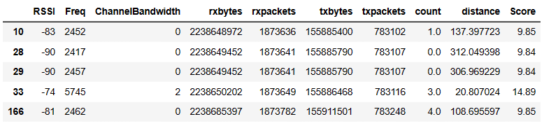
Data collected from app

Slide 7
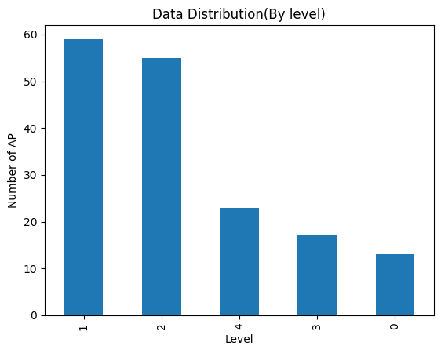
More about data
Total size of data was 5978 rows .
After preprocessing it came down to 167 rows
As in the graph shown, this was the distribution of data according to the level.

Slide 8
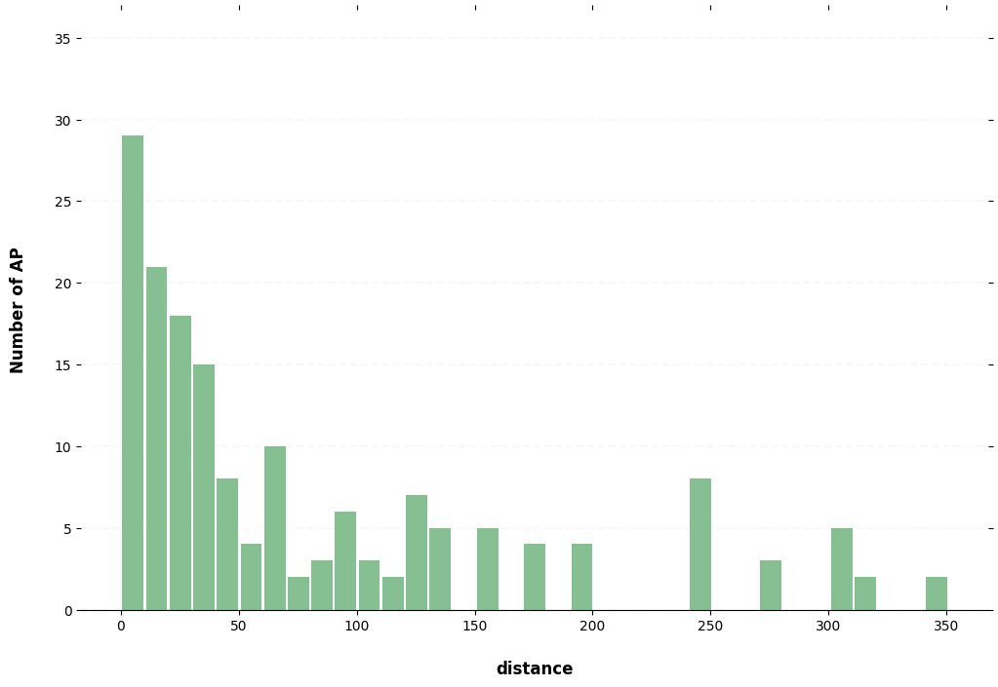
How far from AP
The data we collected was mostly less than 50mtr.

Slide 9
Formula Used
NScore= (pow((100+RSSI)/10),2) +Freq/1000 + (1+ (14/1 + 0.02*distance)) + count +ChannelBandwidth
traffic Score = np.log2(rxbytes) + np.log2(rxpackets) + np.log2(txbytes) + np.log2(txpackets)
range = max(trafficScore)-min(trafficScore)
scale = max(trafficScore)/min(trafficScore)
mini = min(trafficScore)
trafficScore = ((trafficScore -mini)*scale)+1
SCORE = NScore + trafficScore

Slide 10
Ml model results
Linear regression Model
Linear Regression is a machine learning algorithm that models the linear relationship between a dependent variable and one or more independent variables.
R^2 value: 0.9410122927444761
Accuracy: 93.34%

Slide 11
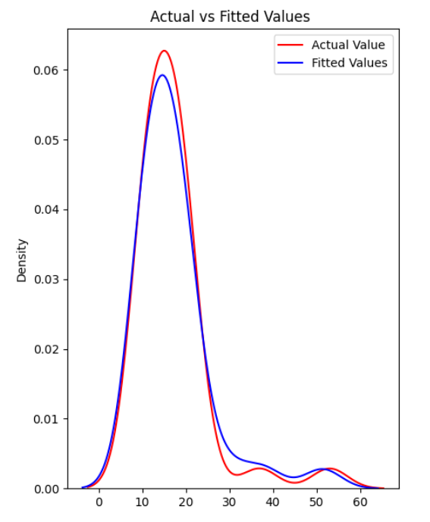
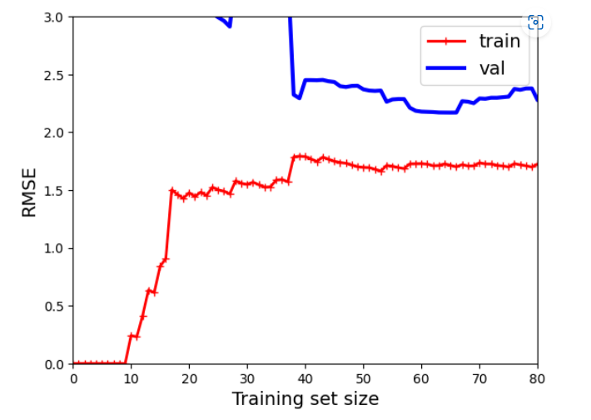

Slide 12
Ml model results
Decision Forest Regressor
A Decision Forest Regressor is an ensemble learning algorithm that combines multiple decision trees to predict a continuous target variable based on the outputs of the individual trees.
max_depth': 12, 'max_features': 10, 'min_samples_leaf': 2,'min_samples_split': 4
R-squared: 0.9506744747444519
Accuracy: 95.76 %.

Slide 13
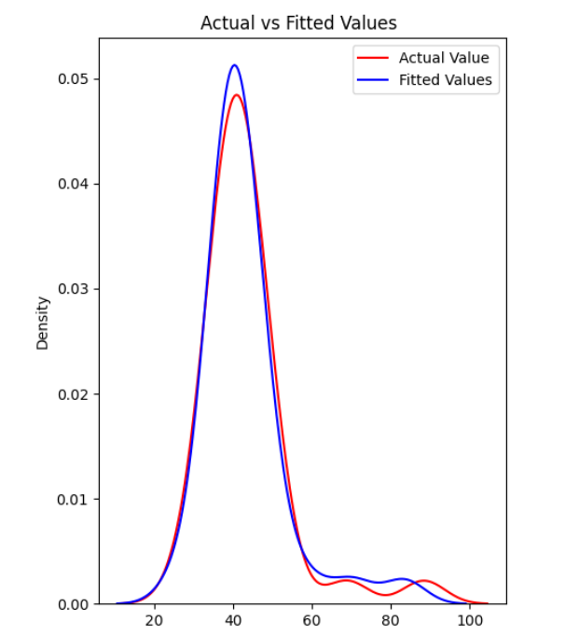
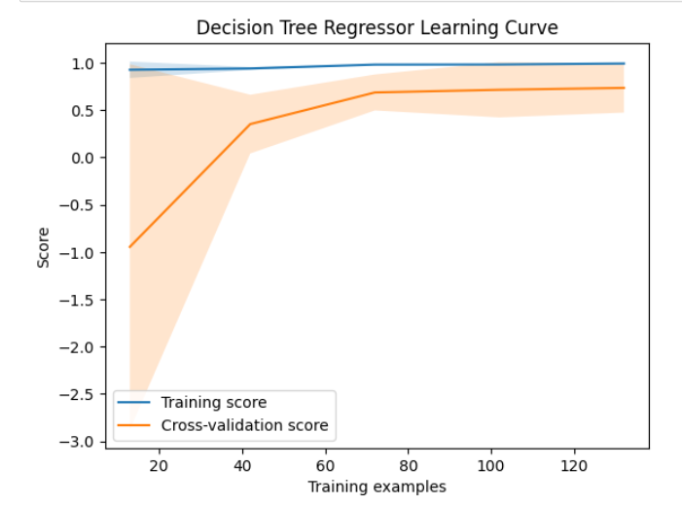

Slide 14
Ml model results
Random Forest Regressor
Random Forest is an ensemble learning algorithm that combines multiple decision trees to improve the performance of the model.
'max_depth': 12, 'max_features': 6, 'min_samples_split': 2, 'n_estimators': 14
R-squared: 0.9676606972692893
Accuracy: 96.64 %.

Slide 15
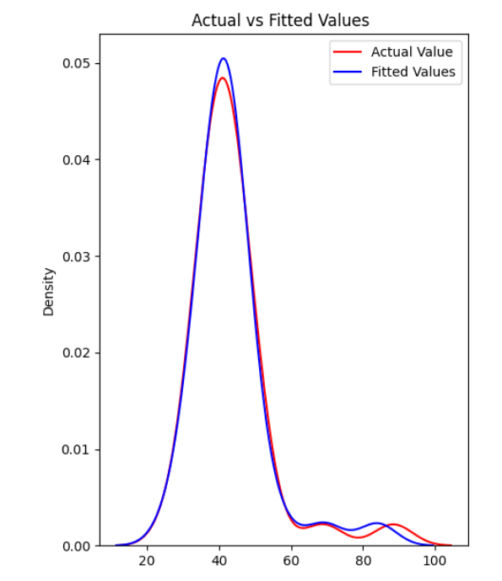
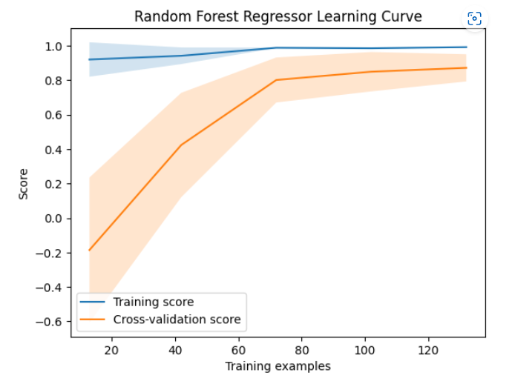

Slide 16
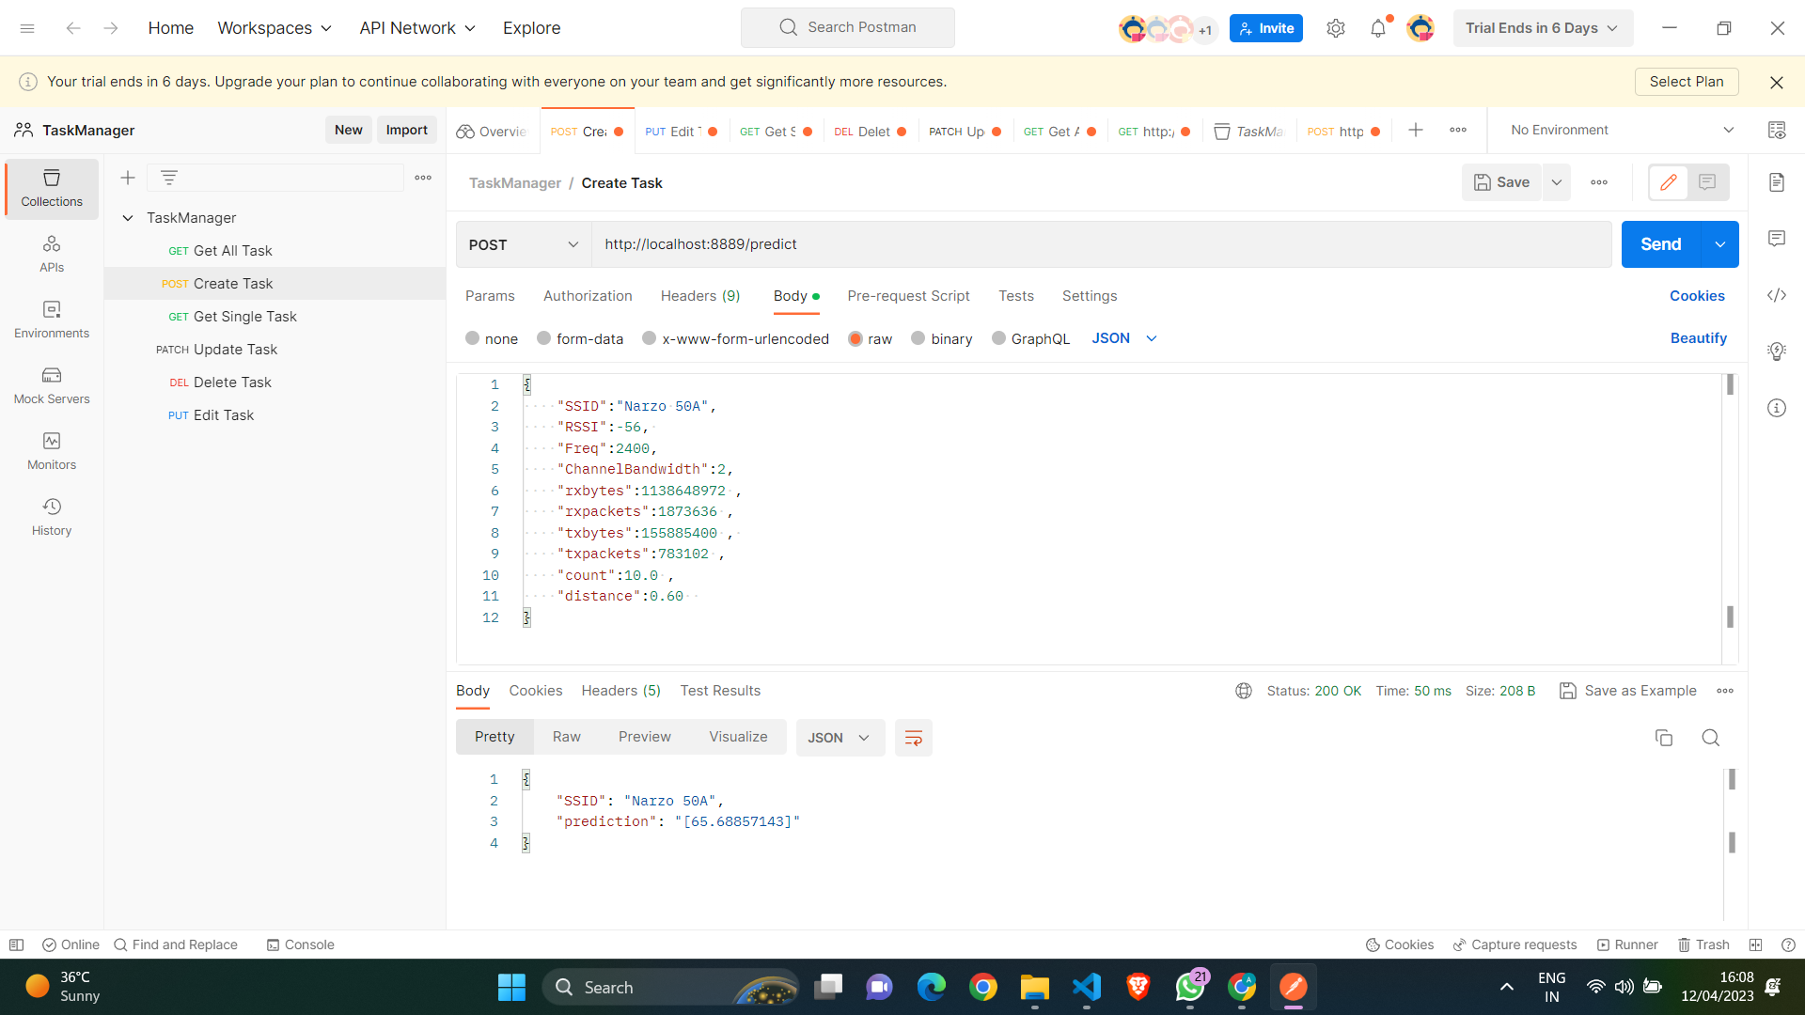
API CALL

Slide 17
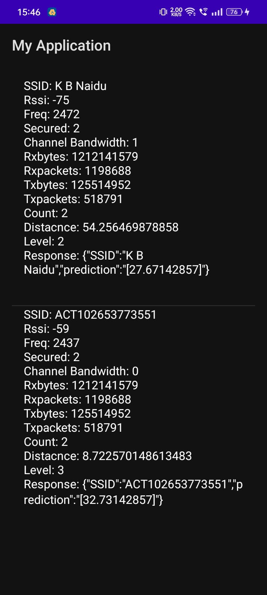
SCREENSHOT OF USER APP

Slide 18
Problems faced by team
Integrating with api
Data set generation
Integrating the api was challenging compared to other tasks as it required learning new concepts and exploring various tools for testing.
Data-set that is generated every 10 seconds is similar to the previous data which causes the data to be overfitted.
Bulk of the dataset falls in the middle region, extreme values are sparse.

Slide 19
Observations
1
Frequently connected wifi’s
2
Ml model
Since the hashset made for obtaining the count of previously connected data is not refreshed periodically, frequently connected AP’s might have very high count score which may lead to bias.
The model is giving a performance of approximately 95% with different models.
3
4
App interface
Sticky band
The current design is minimalist, improvements could be made to suit user requirements.
When we will be able to switch to the best performing AP nearby then this can be solved

Slide 20
Upcoming Month’s plan
Threshold based algorithm
Exploration of advanced ml models
The threshold based algorithm will consider more parameters and conditions as described in google scoring algorithm
We can explore advanced algorithms like GAN, Deep Nearest Neighbour
App interface
Comparison with the ml model and threshold
App interface improvement
A wide variety of data set will be collected.

Slide 21
Thank you

